Slide 1
approximate counting and sampling
贺天行 廖予科 周志明

Slide 2
Outline
1.Introduce the definition of FPRAS and FPAUS
2.Establish the equivalence of approxi.counting and approxi.sampling
3.Introduce the Markov chain
4.Give a example that uses MC to do counting perfect matching on bipartite graph

Slide 3
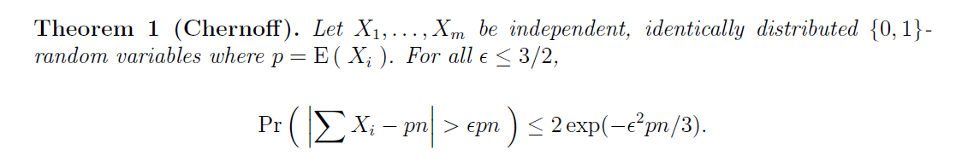
Chernoff’s bound
We’ll use Chernoff’s bound in our proof.

Slide 4
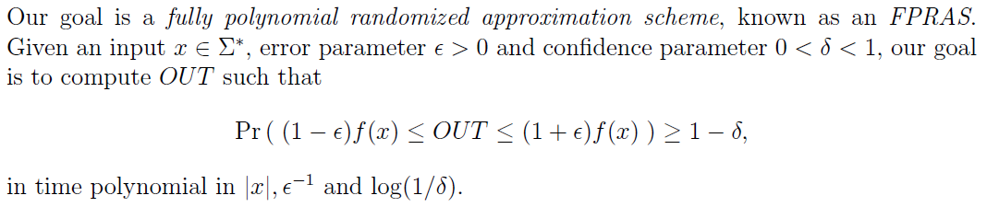
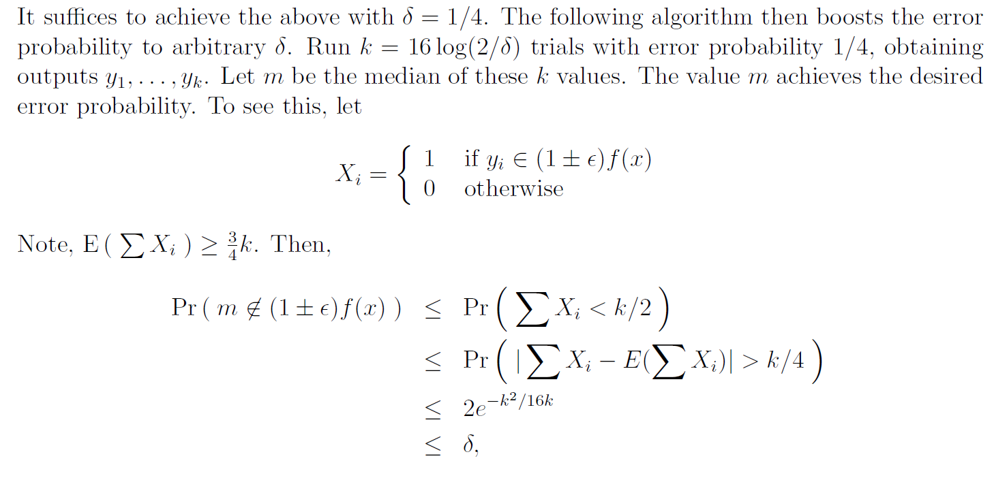
FPRAS
In fact it’s enough to set the δ to ¼，because we can use boosting

Slide 5
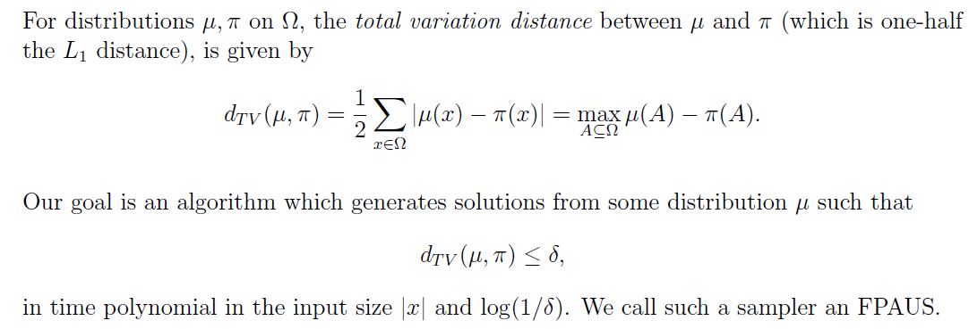
FPAUS

Slide 6
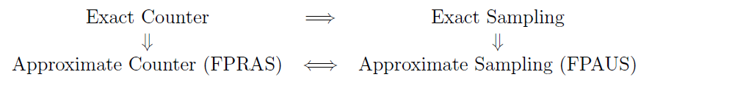
Equivalence
In class, we will sketch the proof of FPRAS <= FPAUS for a self-reducible problem.

Slide 7
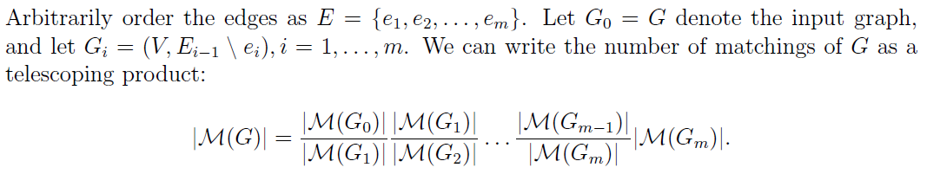
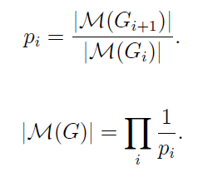
Now we find ways to estimate p_{i}

Slide 8
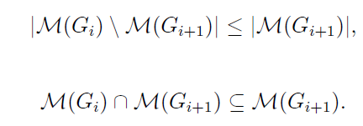



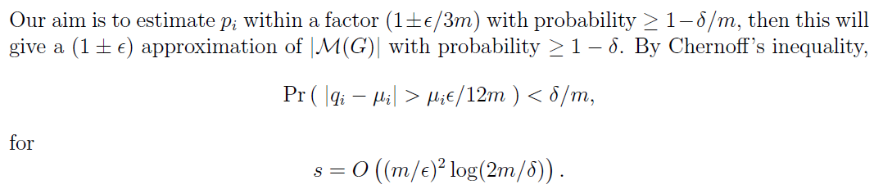
We have
We get p_{i} >= ½, so we don’t need so many samples
We sample from a distribution from the uniform distribution
Draw s random samples, let q_{i} denote the ratio of matchings of G_{i+1}in G_{i}
Let
Then we have

Slide 9
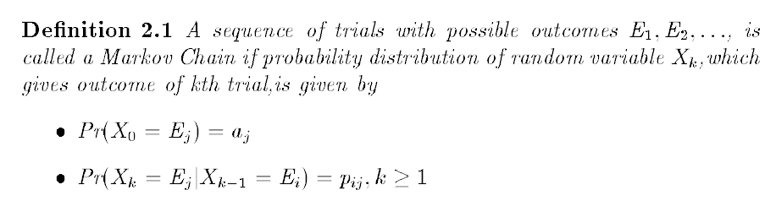
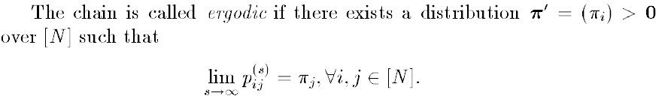
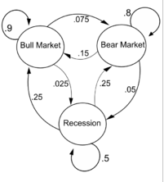
3.Introduce the Markov chain

Slide 10
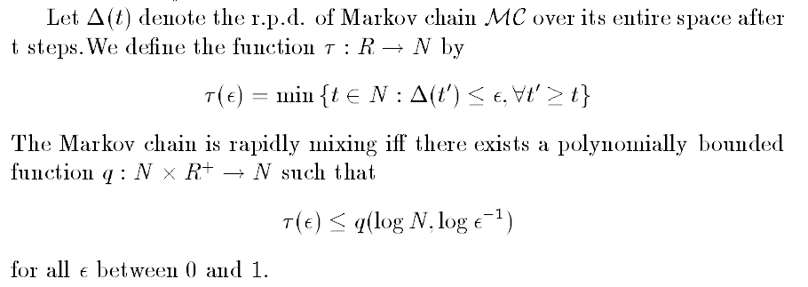
Rapid Mixing
Rapid mixing means, if I start from some state and walk enough long, I will soon get to a distribution, so we have almost uniform geneator

Slide 11
